Slide 1
VLSI SoC 2021
Singapore, October 4 – 8 2021

Slide 2
The Conference
General Chairs
Anupam Chattopadhyay (NTU, SG)
Andrea Calimera (Politecnico di Torino, IT)
Program Chairs
Chip Hong Chang (NTU, SG)
Victor Grimblatt (Synopsys, CL)
Conference topics
Edge computing
Acceleration of data-analytics
Security issues

Slide 3
TPC
8 sub tracks
Track 1: AMS, Sensors, and RF
Track 2: VLSI Circuits and SoC Design
Track 3: Embedded Systems Design & Software
Track 4: CAD Tools and Methodologies for Digital IC Design & Optimization
Track 5: Verification, Modeling and Prototyping
Track 6: Design for Testability, Reliability and fault Tolerance -
Track 7: Hardware Security
Track 8: Emerging Technologies and New Computing Paradigms

Slide 4
Statistics
Submissions: 75
58: main conference
8: Special Sessions
9: PhD Forum
Accepted : 44
Main conference: 29 (19 for oral presentation, 10 for poster)
PhD Forum: 8
Special Session: 7
Acceptance rate: 50%

Slide 5
Statistics by Track
Track | Submissions | Accepted | Acceptance rate | PC members
Analog, Mixed Signal, Sensors and RF | 6 | 3 | 50% | 15
CAD Tools and Methodologies for Digital IC Design & Optimization | 5 | 3 | 60% | 14
Design for Testability, Reliability and Fault Tolerance | 6 | 5 | 83% | 15
Embedded Systems Design & Software | 5 | 3 | 60% | 14
Emerging Technologies and New Computing Paradigms | 14 | 7 | 50% | 15
Hardware Security | 5 | 2 | 40% | 17
Verification, Modeling and Prototyping | 7 | 2 | 29% | 12
VLSI Circuits and SoC Design | 10 | 4 | 40% | 21

Slide 7
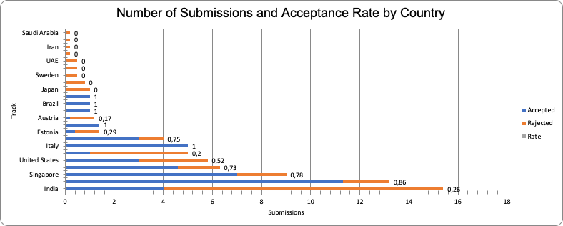

Slide 8
Keynotes and Industrial Talks
3 keynotes
The Deep Learning Software Stack: What Every NN Accelerator Architect Should Know, Kurt Keutzer, UC Berkeley, USA
Preventing Secret leaks from Edge Devices, Ruby Lee, Princeton University, USA
Efficient Neuromorphic Chips With Emerging Circuits and Technologies, Damien Querlioz, CNRS, Université Paris-Saclay, France
3 Industrial talks
Running Privacy-aware Machine Learning Applications on Edge Devices, Kaniskha Bhaduri, Apple, USA
Sunil Cheruvu, Intelligent Edge security challenges and HW based technologies to the rescue, Intel, USA
Optimizing memory device technology for energy efficient AI hardware, Peter Debacker, IMEC, Belgium

Slide 9
Special Sessions
Special session 1: Secure hardware architectures
Organizer: Nele Mentens, KU Leuven and University of Leiden
Special session 2: Towards Reliable In-Memory Computing: From Emerging Devices to Post-von-Neumann Architectures
Organizers: Hussam Amrouch and Ilia Polian, University of Stuttgart, Germany
Special session 3:Intelligent, Secure, Efficient Cyber-Physical Systems on Heterogeneous System on Chips
Organizers: Apostolos P. Fournaris, Aris Lalos, Industrial Systems Institute, Research Centre ATHENA, PSP building, Platani, Greece.

Slide 10
