Slide 1
University of Patras
30th IFIP/IEEE International Conference
on Very Large Scale Integration
(VLSI-SoC 2022)
Odysseas Koufopavlou, Professor
George Theodoridis, Ass. Professor
odysseas, theodor@ece.upatras.gr

Slide 2
VLSI-SoC 2022
Place: Conference and Cultural Centre
University of Patras
Patras, Greece
Date: October Monday 3 – Wednesday 5, 2022

Slide 3
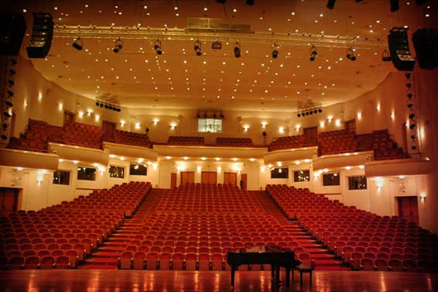
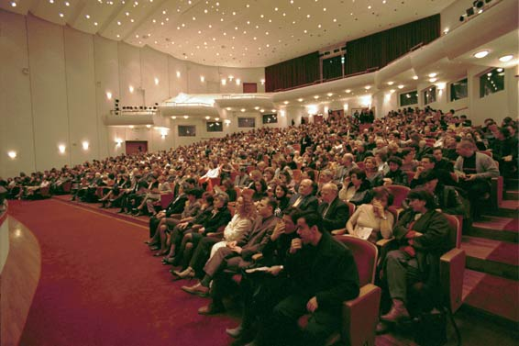
Conference and Cultural Centre of the University of Patras

Slide 4
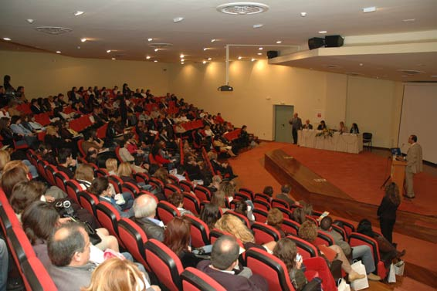
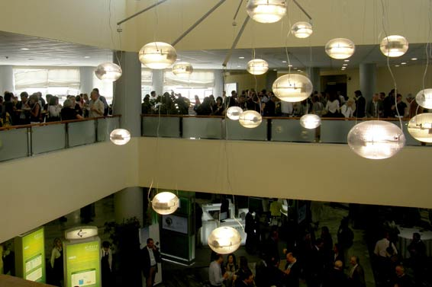
Conference and Cultural Centre of the University of Patras

Slide 5
Conference and Cultural Centre of the University of Patras
The Conference and Cultural Center is an autonomous meeting and exhibition complex of spaces. It is built in a 6 acre area, located in the University Campus, 7 Km east of the city of Patras, in the area of Rion. It has been built in two levels in a total surface area of 9.300 sqm and may host up to 2000 participants. The Conference and Cultural Centre includes: A Main Hall of 930 seats, with four translation studios and a 700 m2 theatrical stage (including its facilities) which is designed to host large orchestras, concerts and theatrical performances.
Underground areas for the construction, storing and safe keeping of theatre sets totalling a surface area of 900 sqm.
A 250 seat Auditorium containing a theatrical stage, its back-stage area and four translation studios.
Four Halls for parallel meetings (one hall of 120 seats and three of 75 seats each), with two translation studios each.

Slide 6
Conference and Cultural Centre of the University of Patras
Four Seminar Halls of 50 seats and four of 45.
A 200 sqm Hall for multiple use.
A two level reception area with a total surface area of 1100 sqm.
60 sqm office space for the administrative support of conferences and other meetings.
Office space for the Centre's administration.
Auxiliary areas.
Accessibility for the disabled.

Slide 7
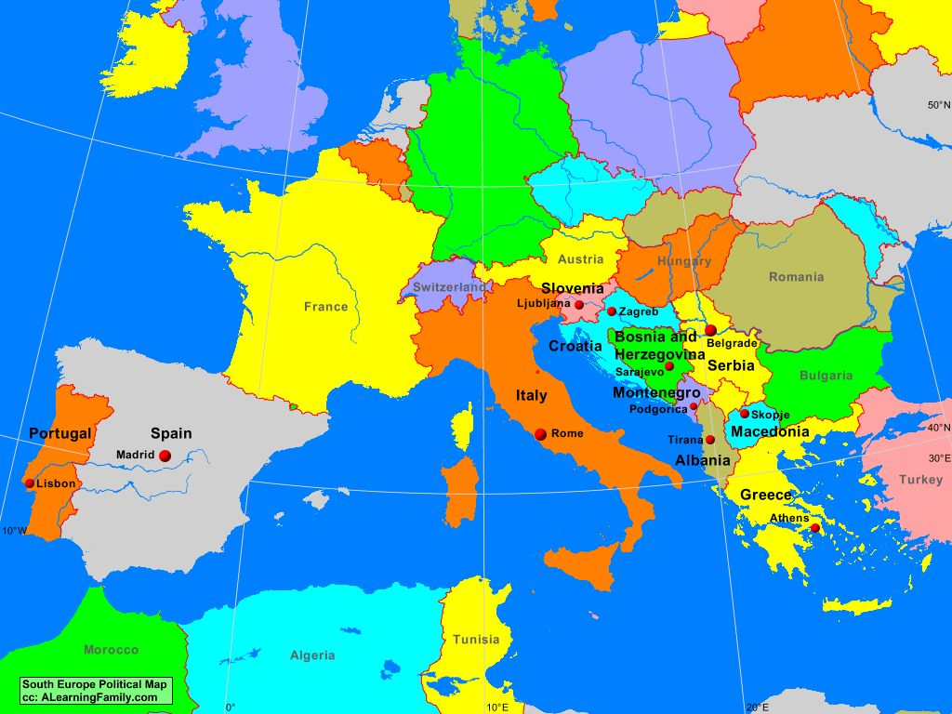
How to Reach Patras
By Air
  From anywhere (Europe, USA, Asia) to Athens International Airport
  By Train or Bus to Patras (Athens – Patras Distance 209 km)
By Boat
  Italian Ports (Ancona, Bari, Brindisi, etc) to Patras port

Slide 8
Where to Stay
Numerous small hotels around University Campus
  Walking Distance
Large Hotels at Patras City or close to the Beach
  3-8 km from the conference center
  We will negotiate special prices for the conference participants

Slide 9
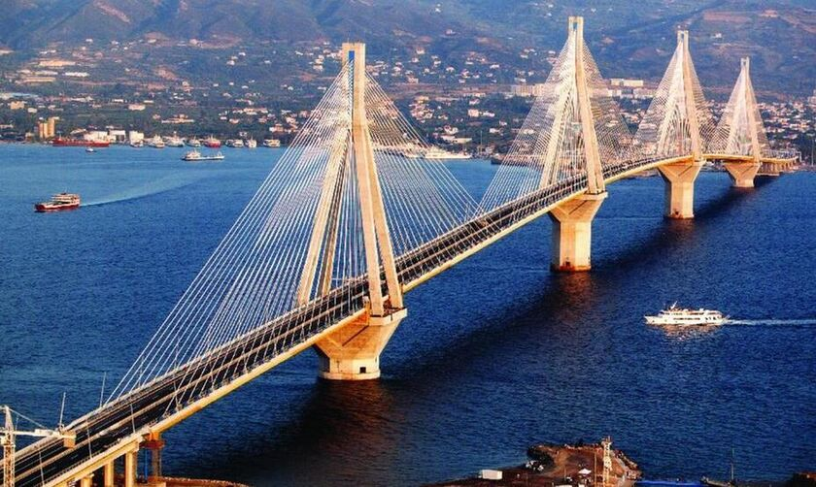
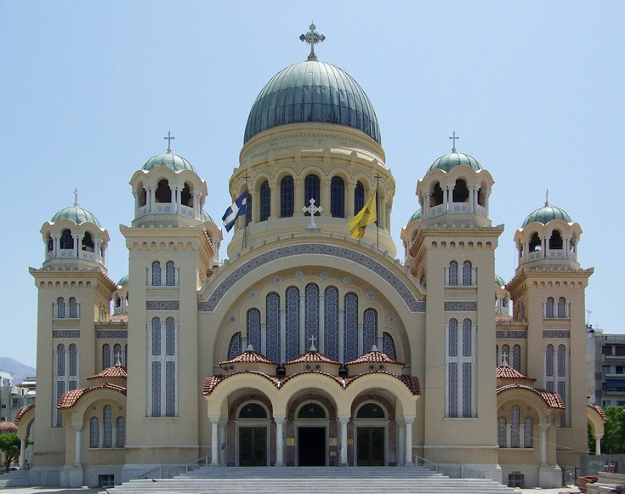
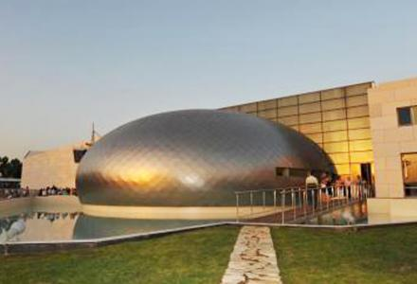
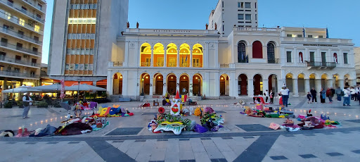
What to Visit – Patras City

Slide 10
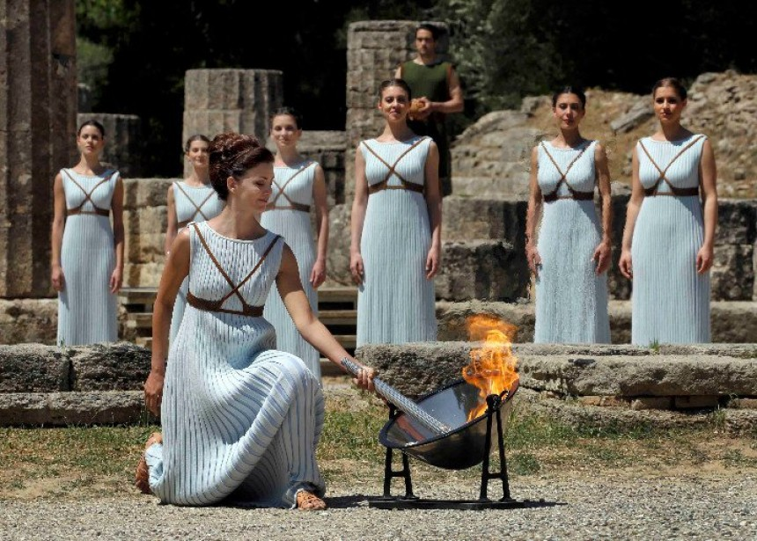
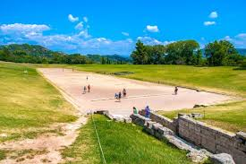
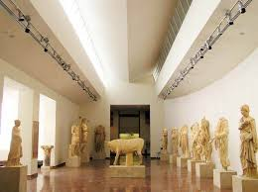
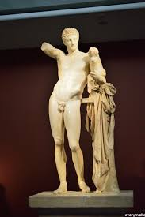
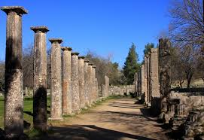
Daily Excursions – Olympia Place

Slide 11

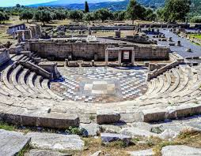
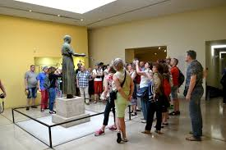
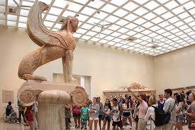
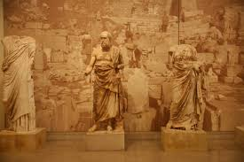
Daily Excursions – Delfoi

Slide 12
Theme and Sponsors
Conference Theme: “SoCs for 5G Evolution and 6G”
Sponsors: IFIP, IEEE, CEDA (IEEE Council on Electronic Design Automation), ACM Sigda, CAS, University of Patras, Synopsys, Computers (Open Access by MDPI)

Slide 13
DATES
Place: Conference and Cultural Centre, University of Patras, Patras, Greece
Date: October 3-5, 2022
Abstract registration: April 18, 2022
Full paper submission: April 25, 2022
Special session proposal: April 25, 2022
Notification of acceptance: June 20, 2022
Camera ready: July 11, 2022
Ph.D. Forum Submission: June 13, 2022
Ph.D. Forum Notification: June 27, 2022
Ph.D. Forum Camera Ready: July 18, 2022

Slide 14
Organizing Committee
General Co-Chairs: Odysseas Koufopavlou (University of Patras, GR), Graziano Pravadelli (University of Verona, IT)
Program Co-chairs: Vassilis Paliouras (University of Patras, GR), Lech Jozwiak (Eindhoven University of Technology, NL)
Special Session Chairs: Dimitrios Soudris (National Technical University of Athens, GR) Apostolis Fournaris (Monash University, AU)
PhD and Student Forum Chair: Ricardo Reis (Universidade Federal do Rio Grande do Sul, BR)
Industrial Chair: Victor Grimblatt (Synopsys, CL)
Local Chair: Nikolas Sklavos (University of Patras, GR)
Publication Chair: Paraskevas Kitsos (University of Peloponnese, GR)
Publicity Co-Chairs: TBD
Finance Chair: George Theodoridis (University of Patras, GR)
Website Co-Chairs: Ioannis Kouretas (University of Patras, GR)

Slide 15
Steering/TPC Committee
Steering Committee: Ibrahim Elfadel (Khalifa University, UAE), Masahiro Fujita (University of Tokyo, JP), Manfred Glesner (TU Darmstadt, DE), Matthew Guthaus (UC Santa Cruz, USA), Salvador Mir (TIMA, FR), Ian O’Connor (ECL, FR), Graziano Pravadelli (University of Verona, IT), Ricardo Reis (UFRGS, BR), Luis Miguel Silveira (INESC ID, PT), Chi-Ying Tsui (HKUST, Hong Kong, CN), Fatih Ugurdag (Ozyegin University, TR)
List of TPC Members: TBD

Slide 16
Plan
September 2021:
  Sign MoU with IEEE
  Contact with Sponsors (Existed and New)
  Registration Fees, Initial Conference Budget
  Call For Papers (Ready for Announcement/Distribution)
  VLSI-SoC 2022 Web Site on Air

Slide 17
