Slide 1
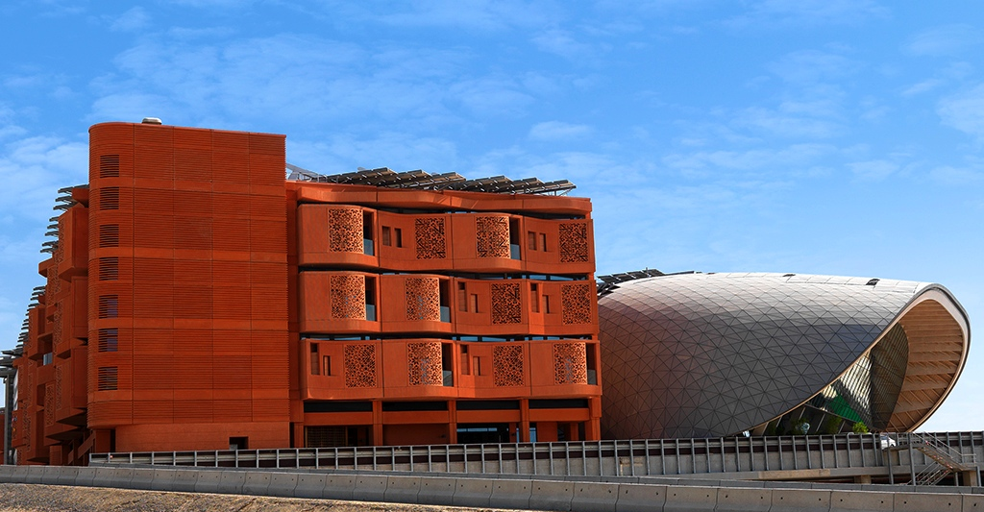


IFIP Working Group 10.5
Update on 2017 VLSI-SoC
Abu Dhabi, UAE
Ibrahim (Abe) Elfadel
Masdar Institute of Science and Technology
Abu Dhabi, UAE
2016 DATE , Dresden, Germany
March 16 2016

Slide 2

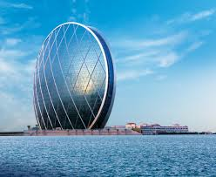
Abu Dhabi in the Gulf Region
$15B investment in semiconductors
6000 patents
15,000 patents (IBM Micro)

Slide 3
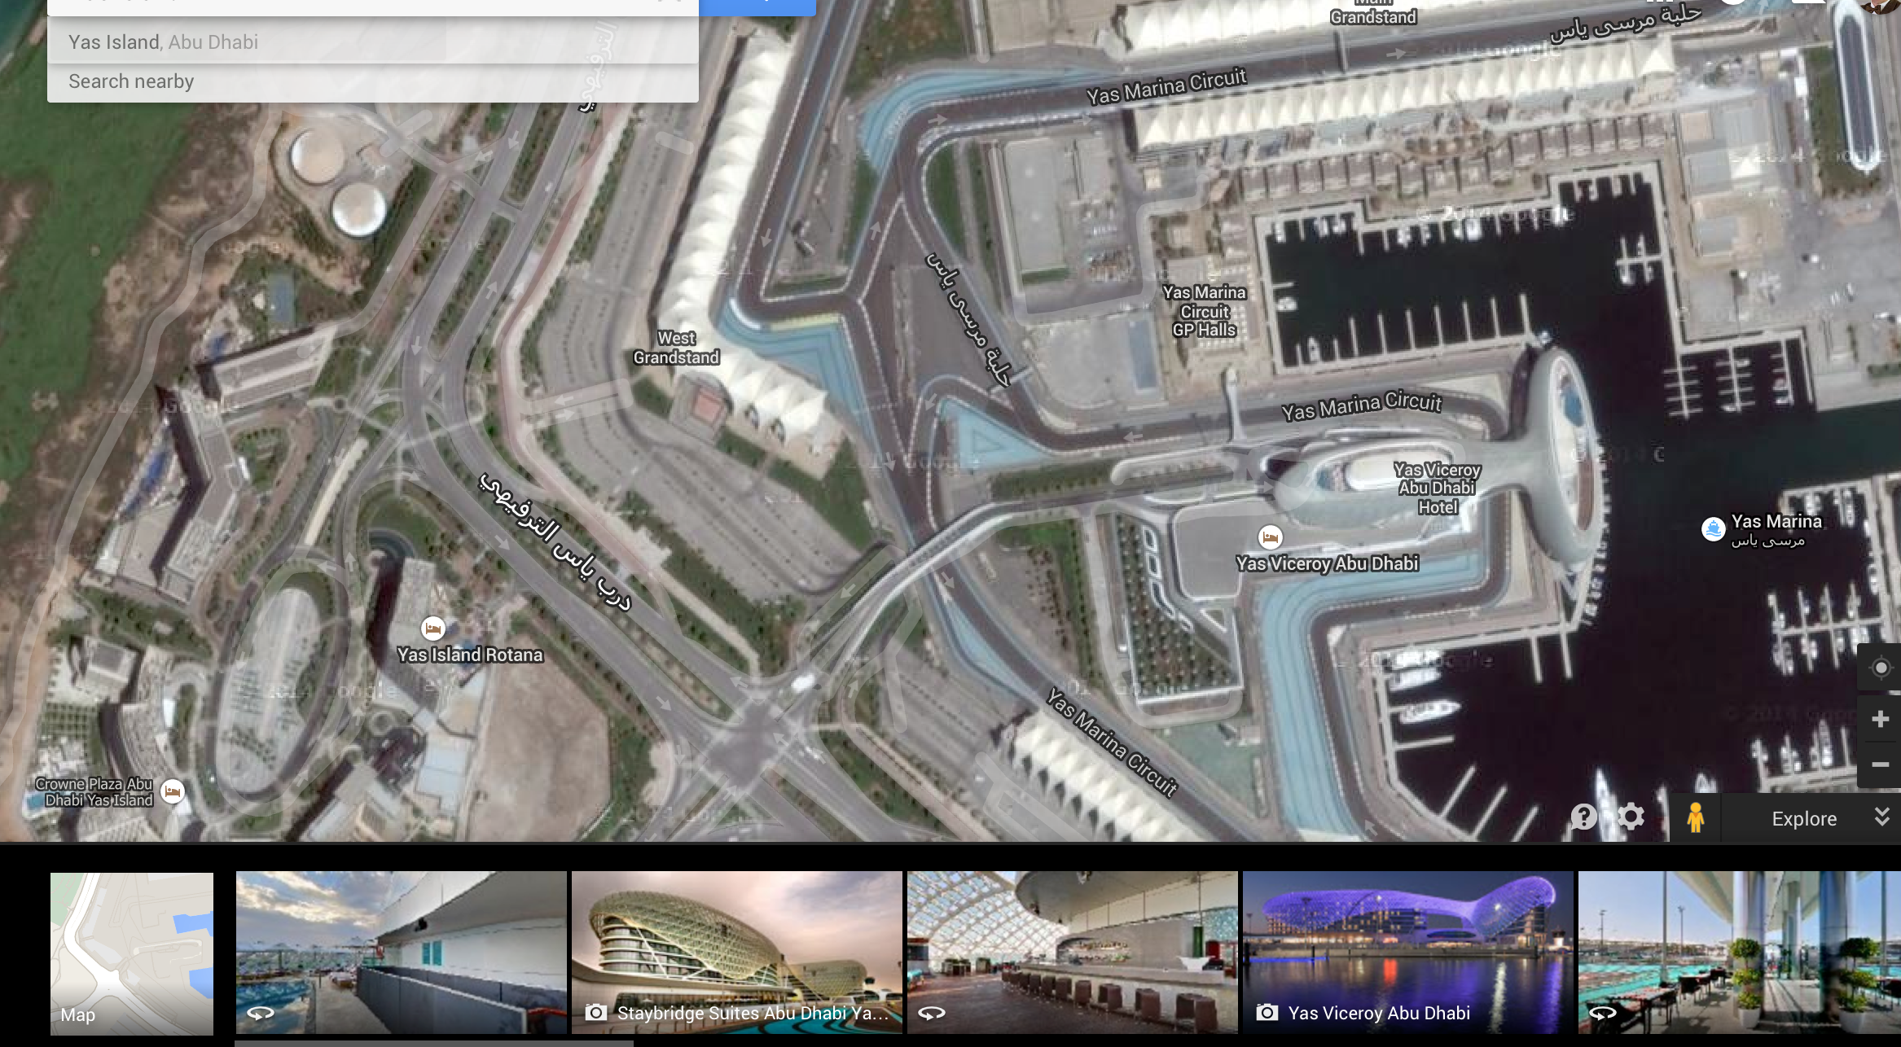
Yas Island Hotels
At two per room, several Yas Island hotels are affordable by students

Slide 4
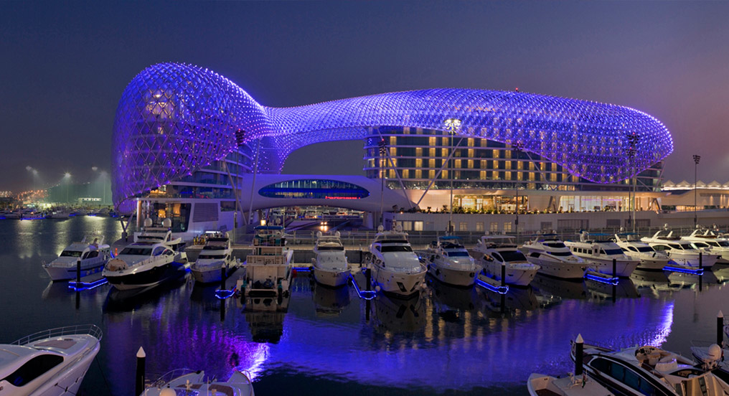
Yas Viceroy
At two per room, several Yas Island hotels are affordable by students

Slide 5
Venue: Yas Viceroy
5-star hotel has grand ballroom and 10 conference rooms
Only 15 minutes from Abu Dhabi International Airport
10 minutes from Masdar City (first zero-carbon footprint city in the world!)
1hr15 minutes from Dubai International Airport
Offer made in Dec 2016
Still active but asked for a revision to reduce hotel rates.

Slide 6
Venue: Yas Viceroy
Meeting rooms are fully capable of hosting plenary and 4 parallel conference lecture sessions, as well as 3 simultaneous committee meetings.
Hosted, in Dec 2013, the 20th IEEE Conference on Electronics, Circuits and Systems (ICECS), which is the Region 8 flagship conference of the IEEE Circuits and Systems Society.
7 international restaurants and a host of amenities
Overlooks the Yas Marina Circuits – Home of the Abu Dhabi Formula 1.

Slide 7
VLSI-SoC 2017 Chairs
General Chairs:
  Ozgur Sinanoglu, NYU Abu Dhabi
    Unfortunately, he will be very busy who other conference commitments. He has proposed Prof. Michail (Mihalis) Maniatakos from NYU-AD to replace him.
  Abe Elfadel, Masdar Institute, Abu Dhabi, UAE
    Technical Co-chair of ICECS 2013 in Abu Dhabi
    Tutorial & Special Session Chair for MWSCAS 2016, Aby Dhabi, UAE
    Co-Director ATIC-SRC Center of Excellence on Energy Efficient Electronic Systems, Abu Dhabi, UAE

Slide 8
VLSI-SoC 2017 Committees
Technical Co-Chairs:
  One from UAE
  One international
    Suggestion: VLSI-SoC Steering Committee

Slide 9
Projected Finances
Two Options:
  Break-even option with registration fees ($400 early registration for IFIP/IEEE/ACM members)
    Total cost: $72,000.
  Full-support option with $0 registration fees

Slide 10
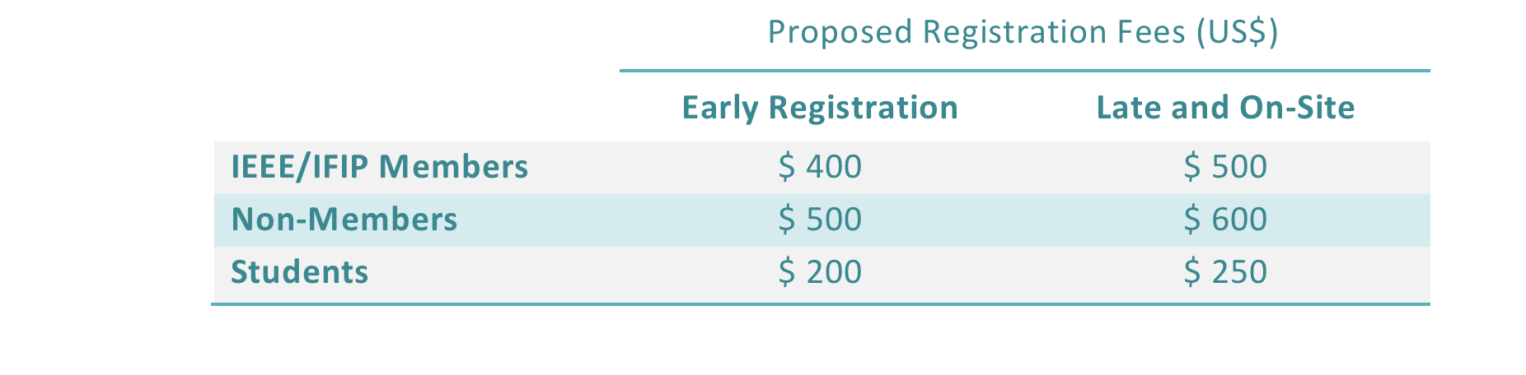
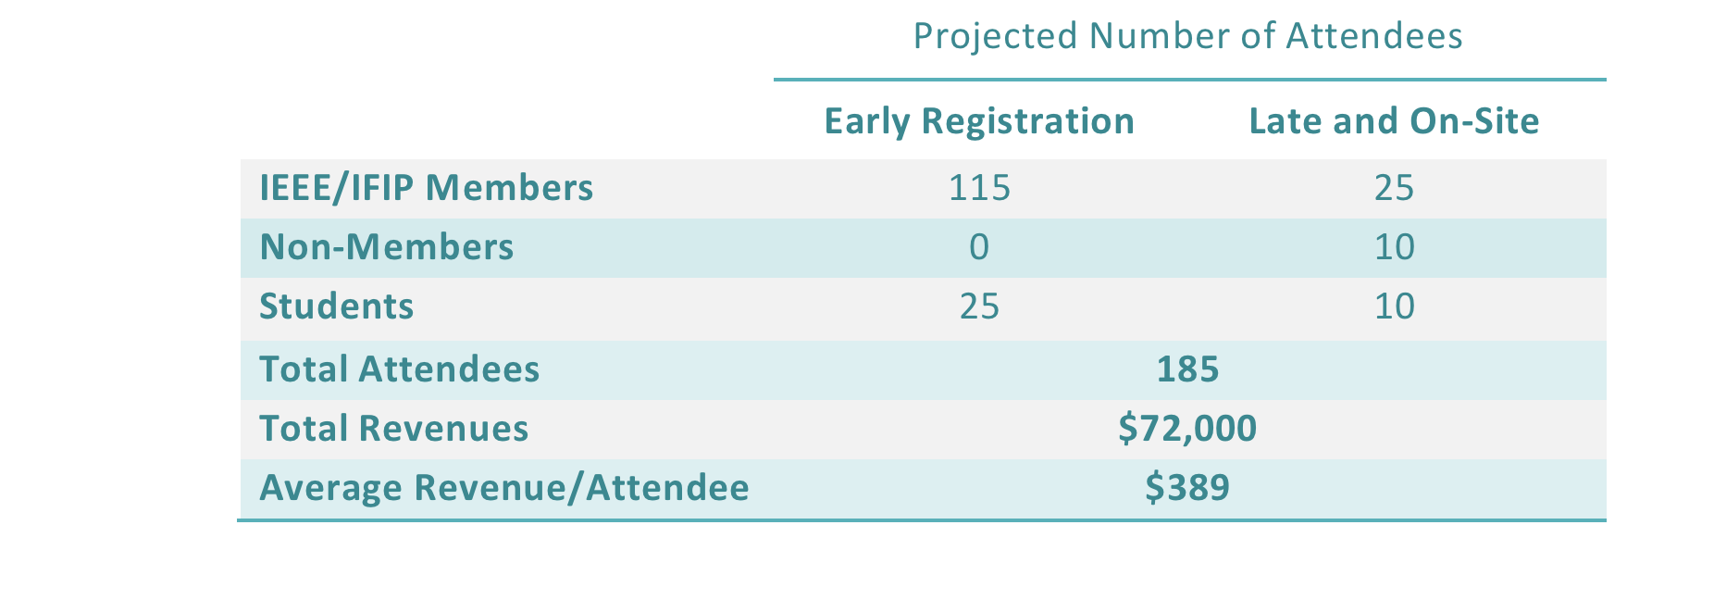
Expected Attendance and Revenue (Revised)

Slide 11
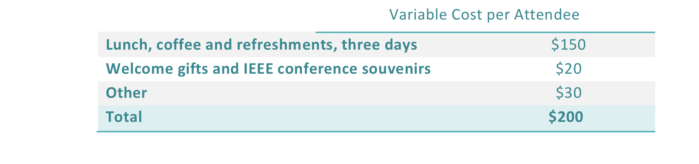
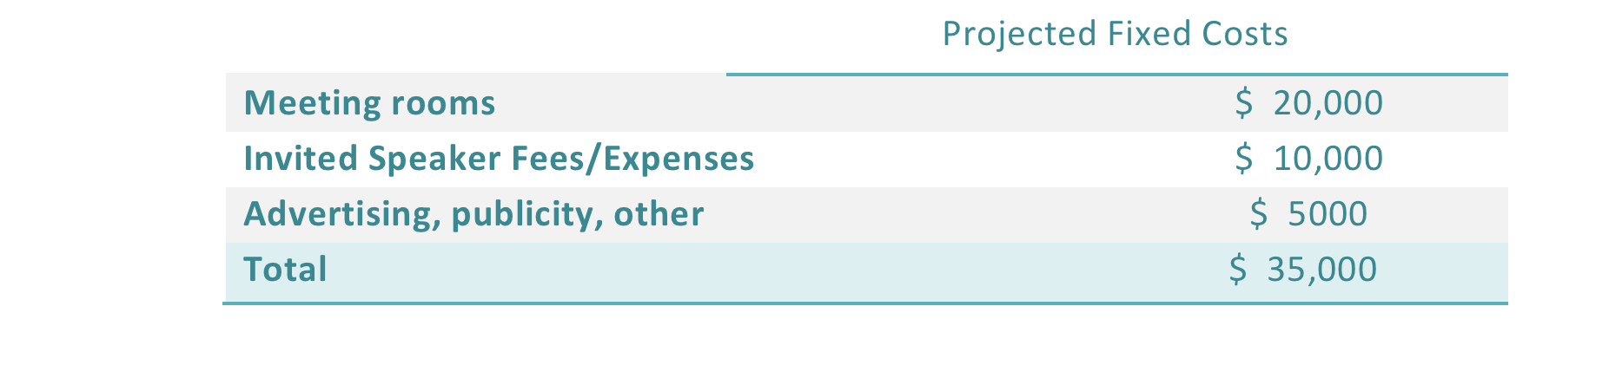
Expected Cost (Revised)
Based on these projected revenues and costs, the conference will break even at 185 attendees and will have a surplus if the number of attendees is any higher than this number.

Slide 12
Possible Support (original)
Abu Dhabi Educational Council:
  Expected: AED250K = US$68K?
Can be used to support increased participation:
  Student travel grant
  Outreach: Faculty travel grant
  Social and co-located activities

Slide 13
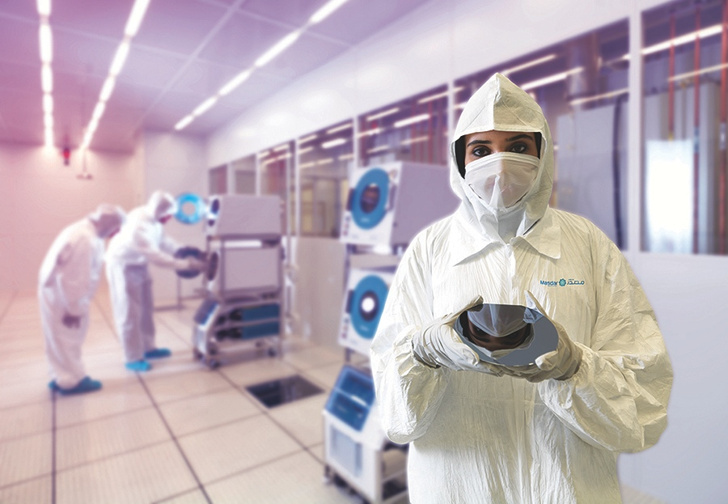
Thank You

